Slide 1
Visual Design Projects
Olivia Zhang
Harvard College Class of 2022
oliviazhang@college.harvard.edu
832-858-0801

Slide 2
Featuring:
1. Global Femtech Market Map 2014-2019
2. VIVE, a web-based conversation visualization tool
3. Cover Art for Harvard Talks, an upcoming podcast
4. Feelings of Color, an interactive color-emotion association website

Slide 3
1. Global Femtech Market Map
Market research on Femtech companies (innovations in women’s healthcare) and trends during internship at Healthcare Growth Partners (2020)
Created in PowerPoint

Slide 4
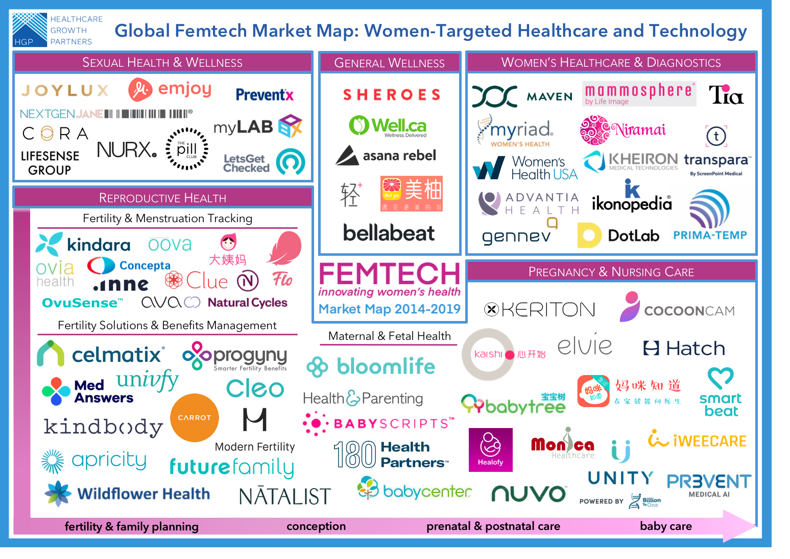

Slide 5
2. Web-based Medical Conversation Visualization Tool Prototype
Research Project at the Carnegie Mellon University Human-Computer Interaction Institute (2019)
Created in Sketch

Slide 6
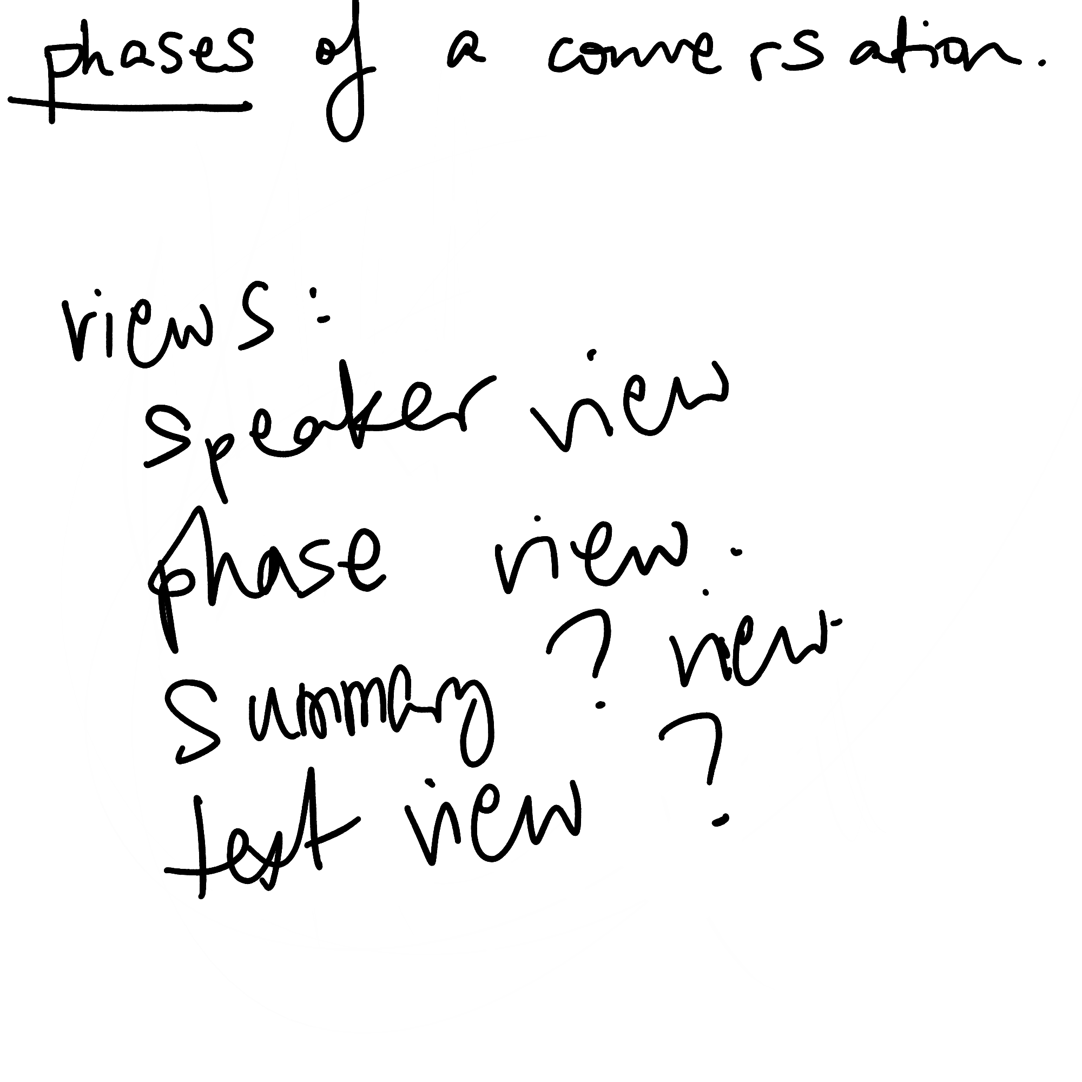
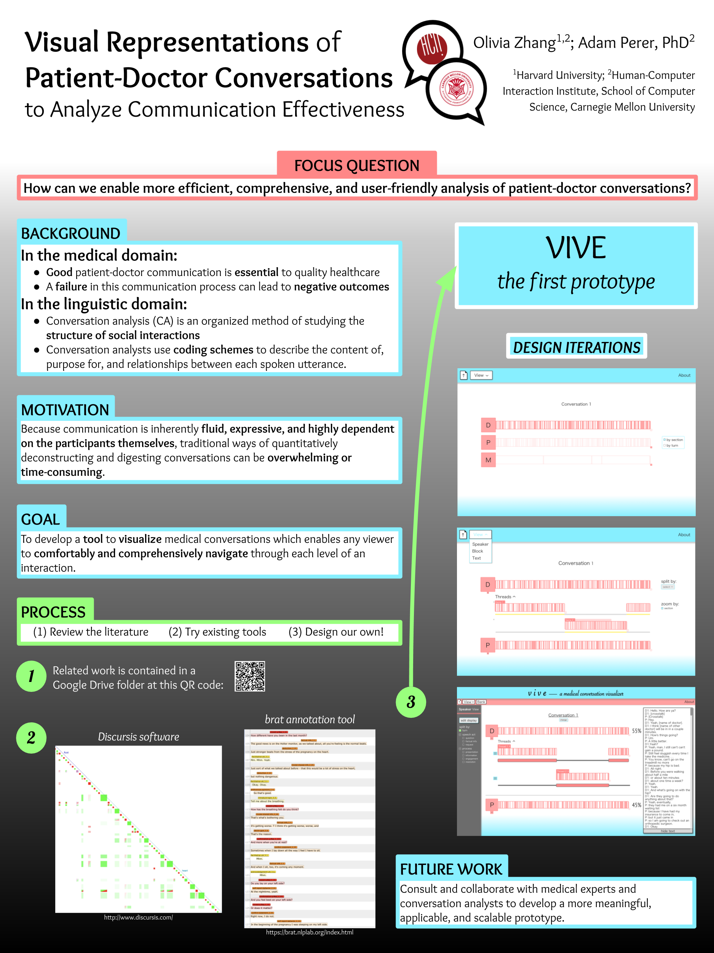
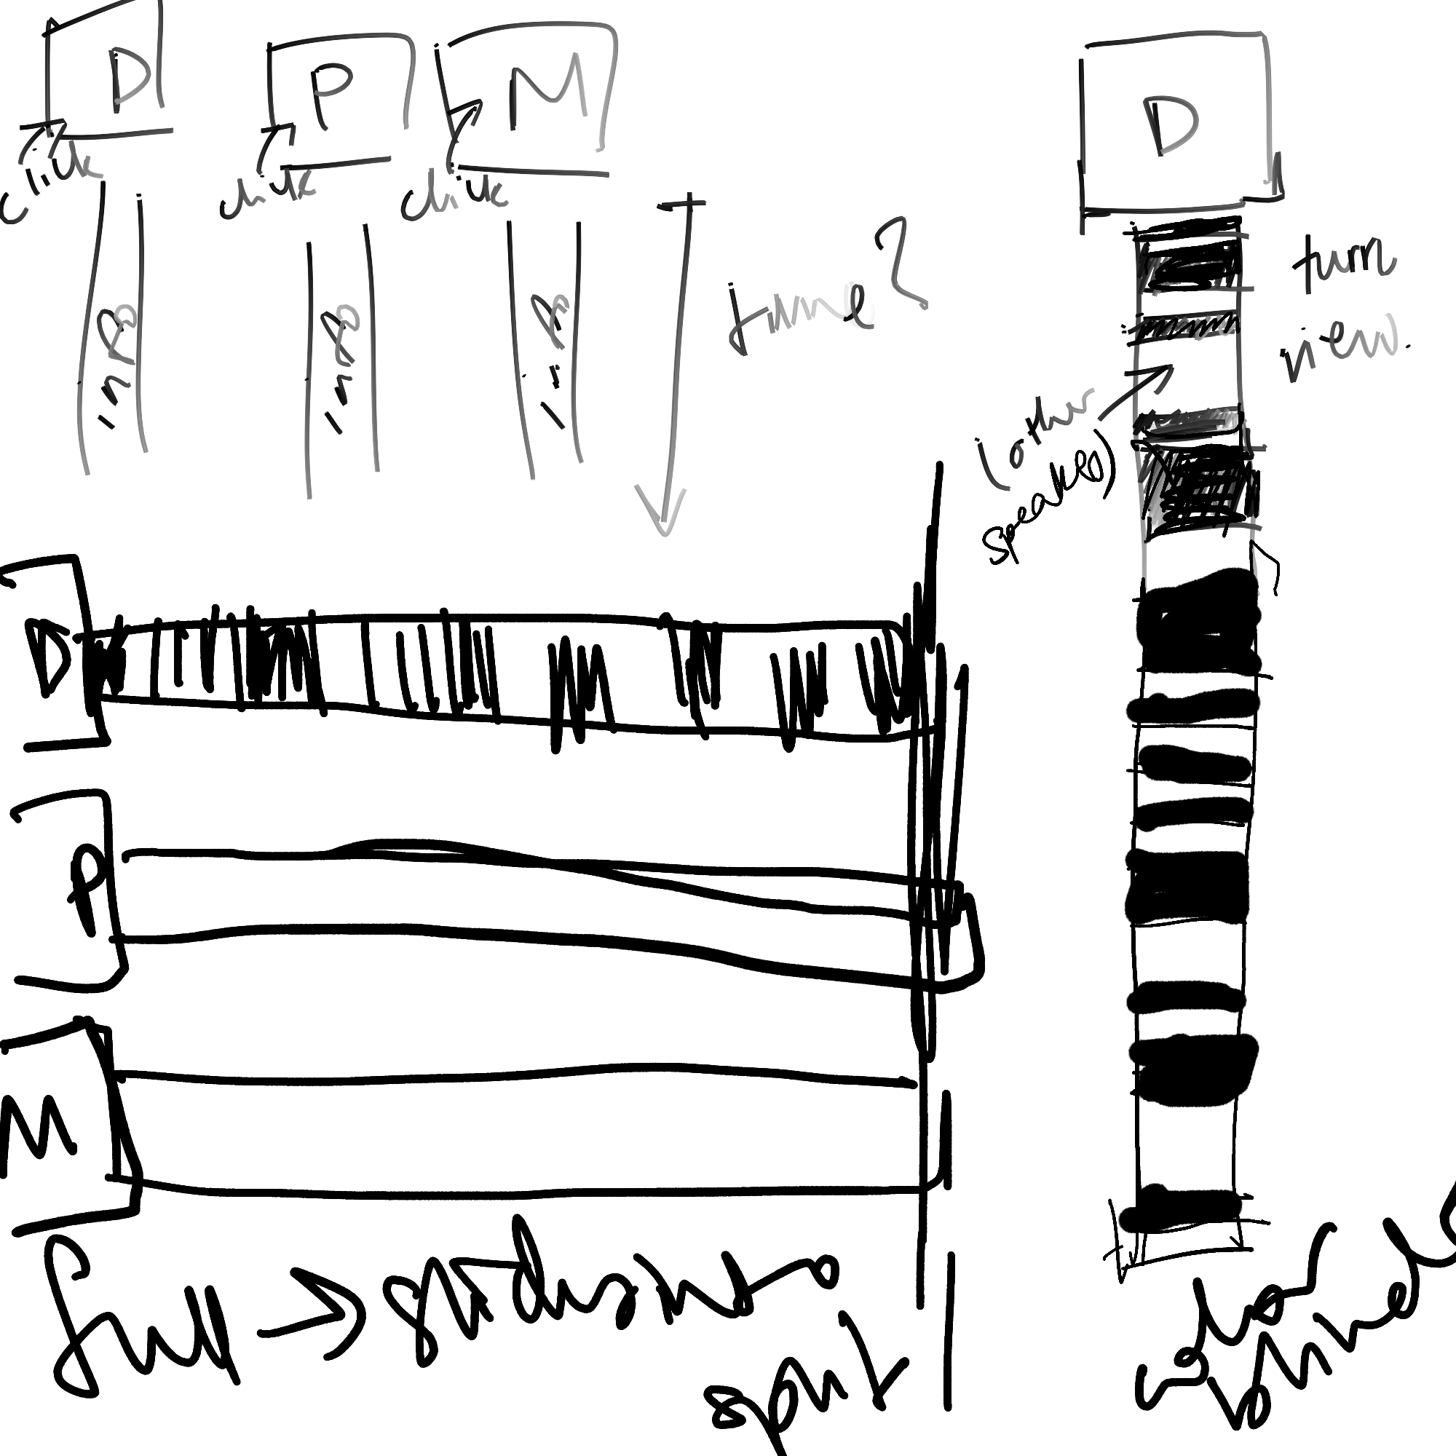
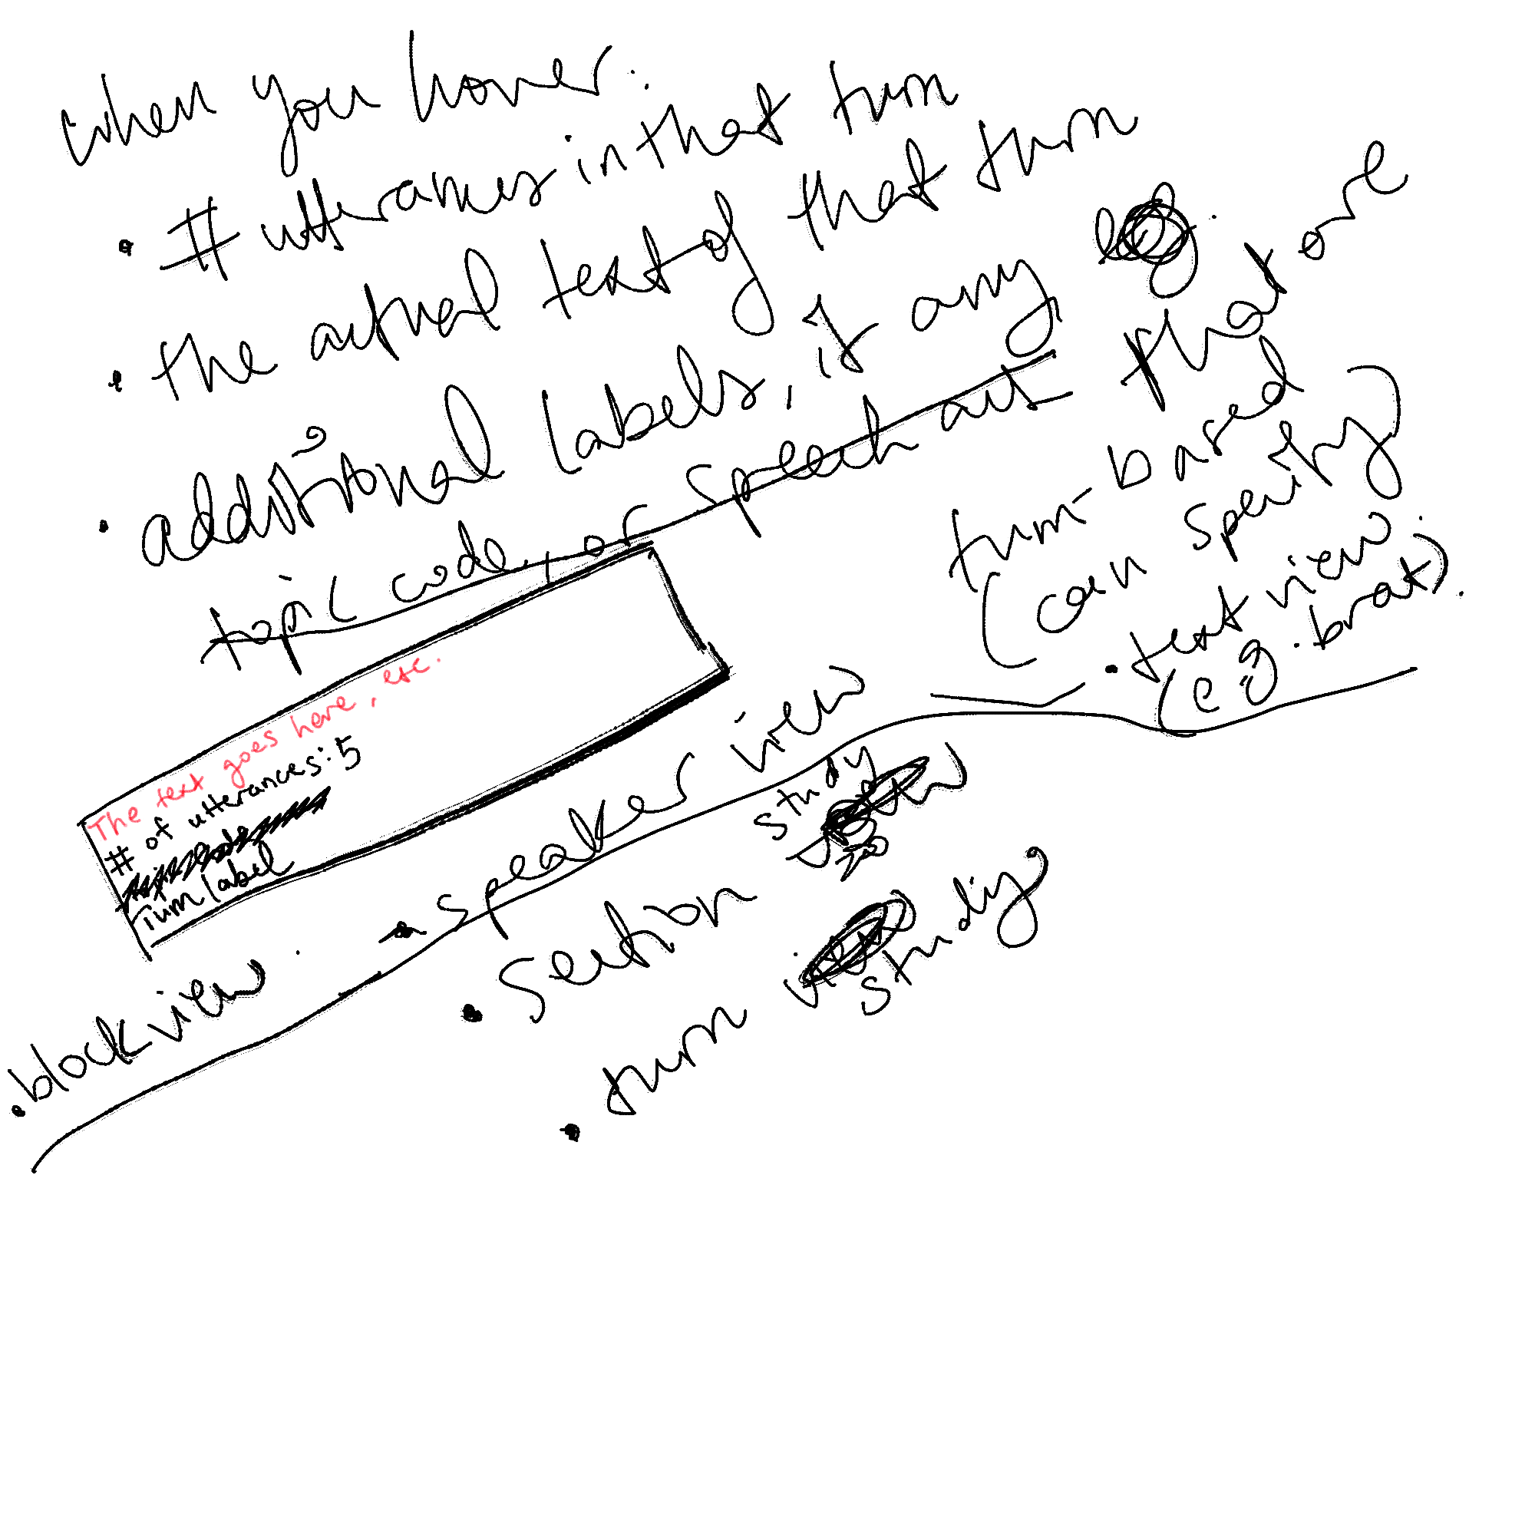
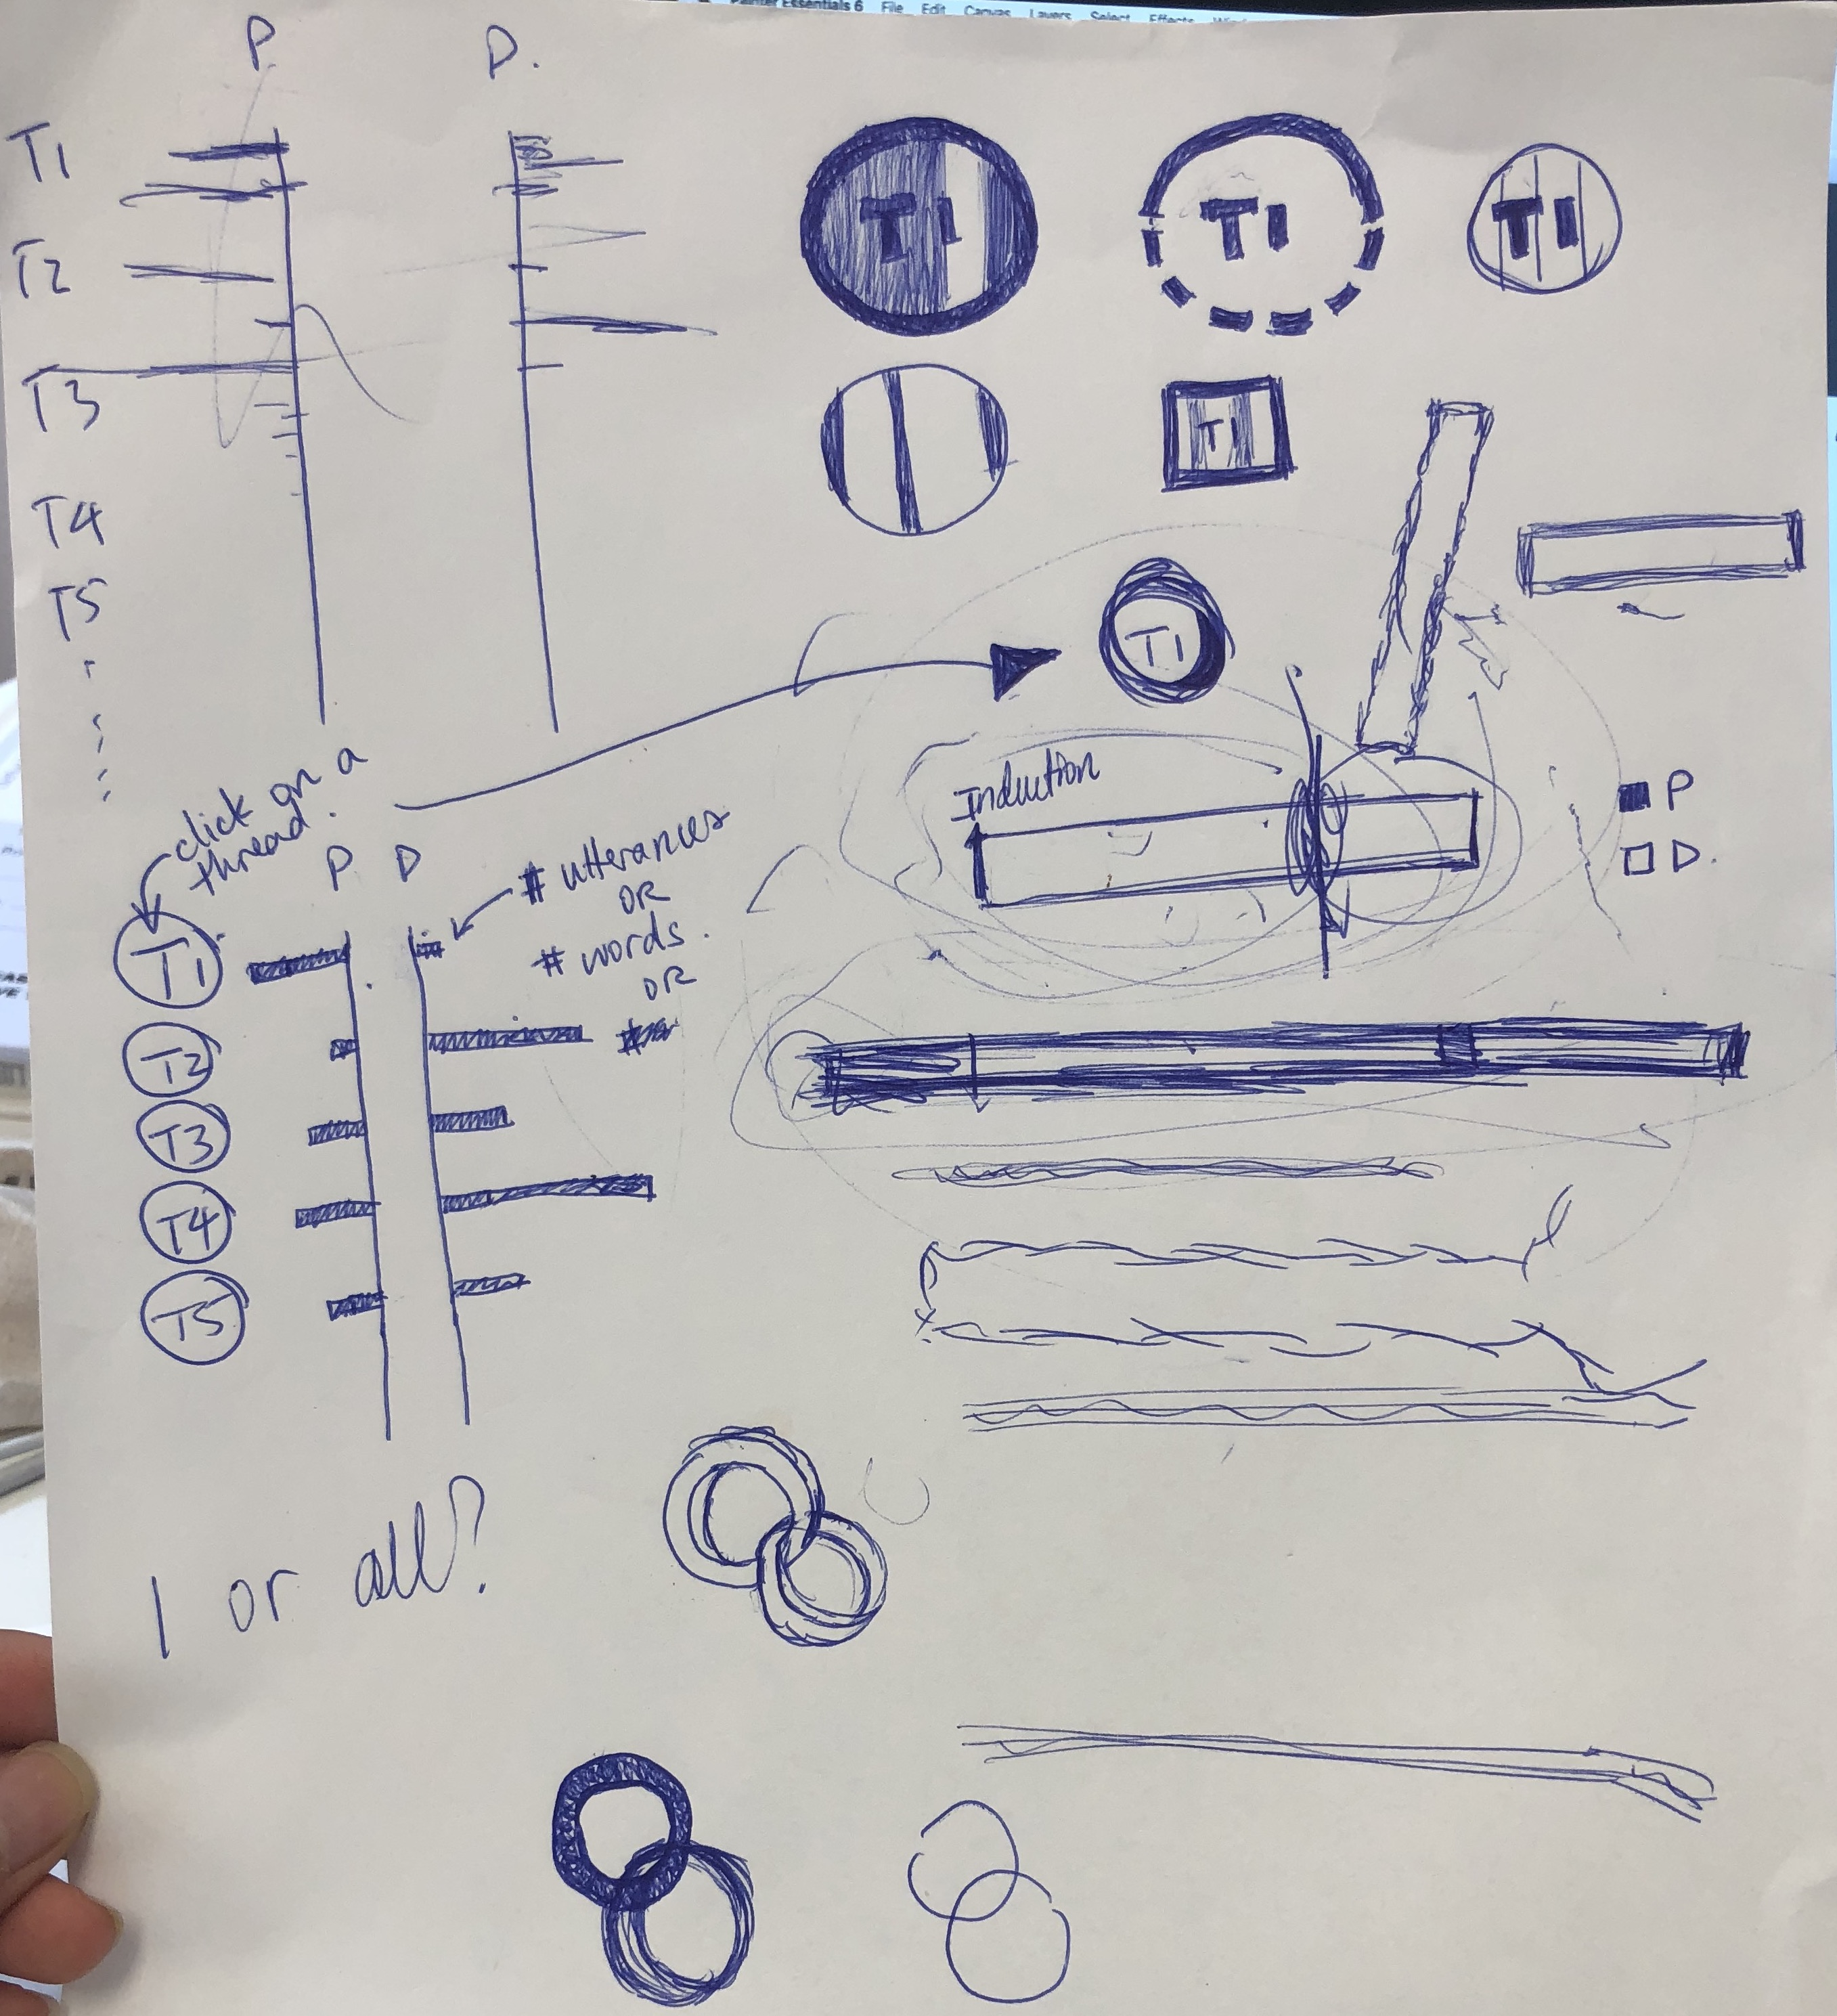
1st phase: some scratch brainstorming and first iterations of the design (shown in the final research poster, which was created mid-iteration process):

Slide 7
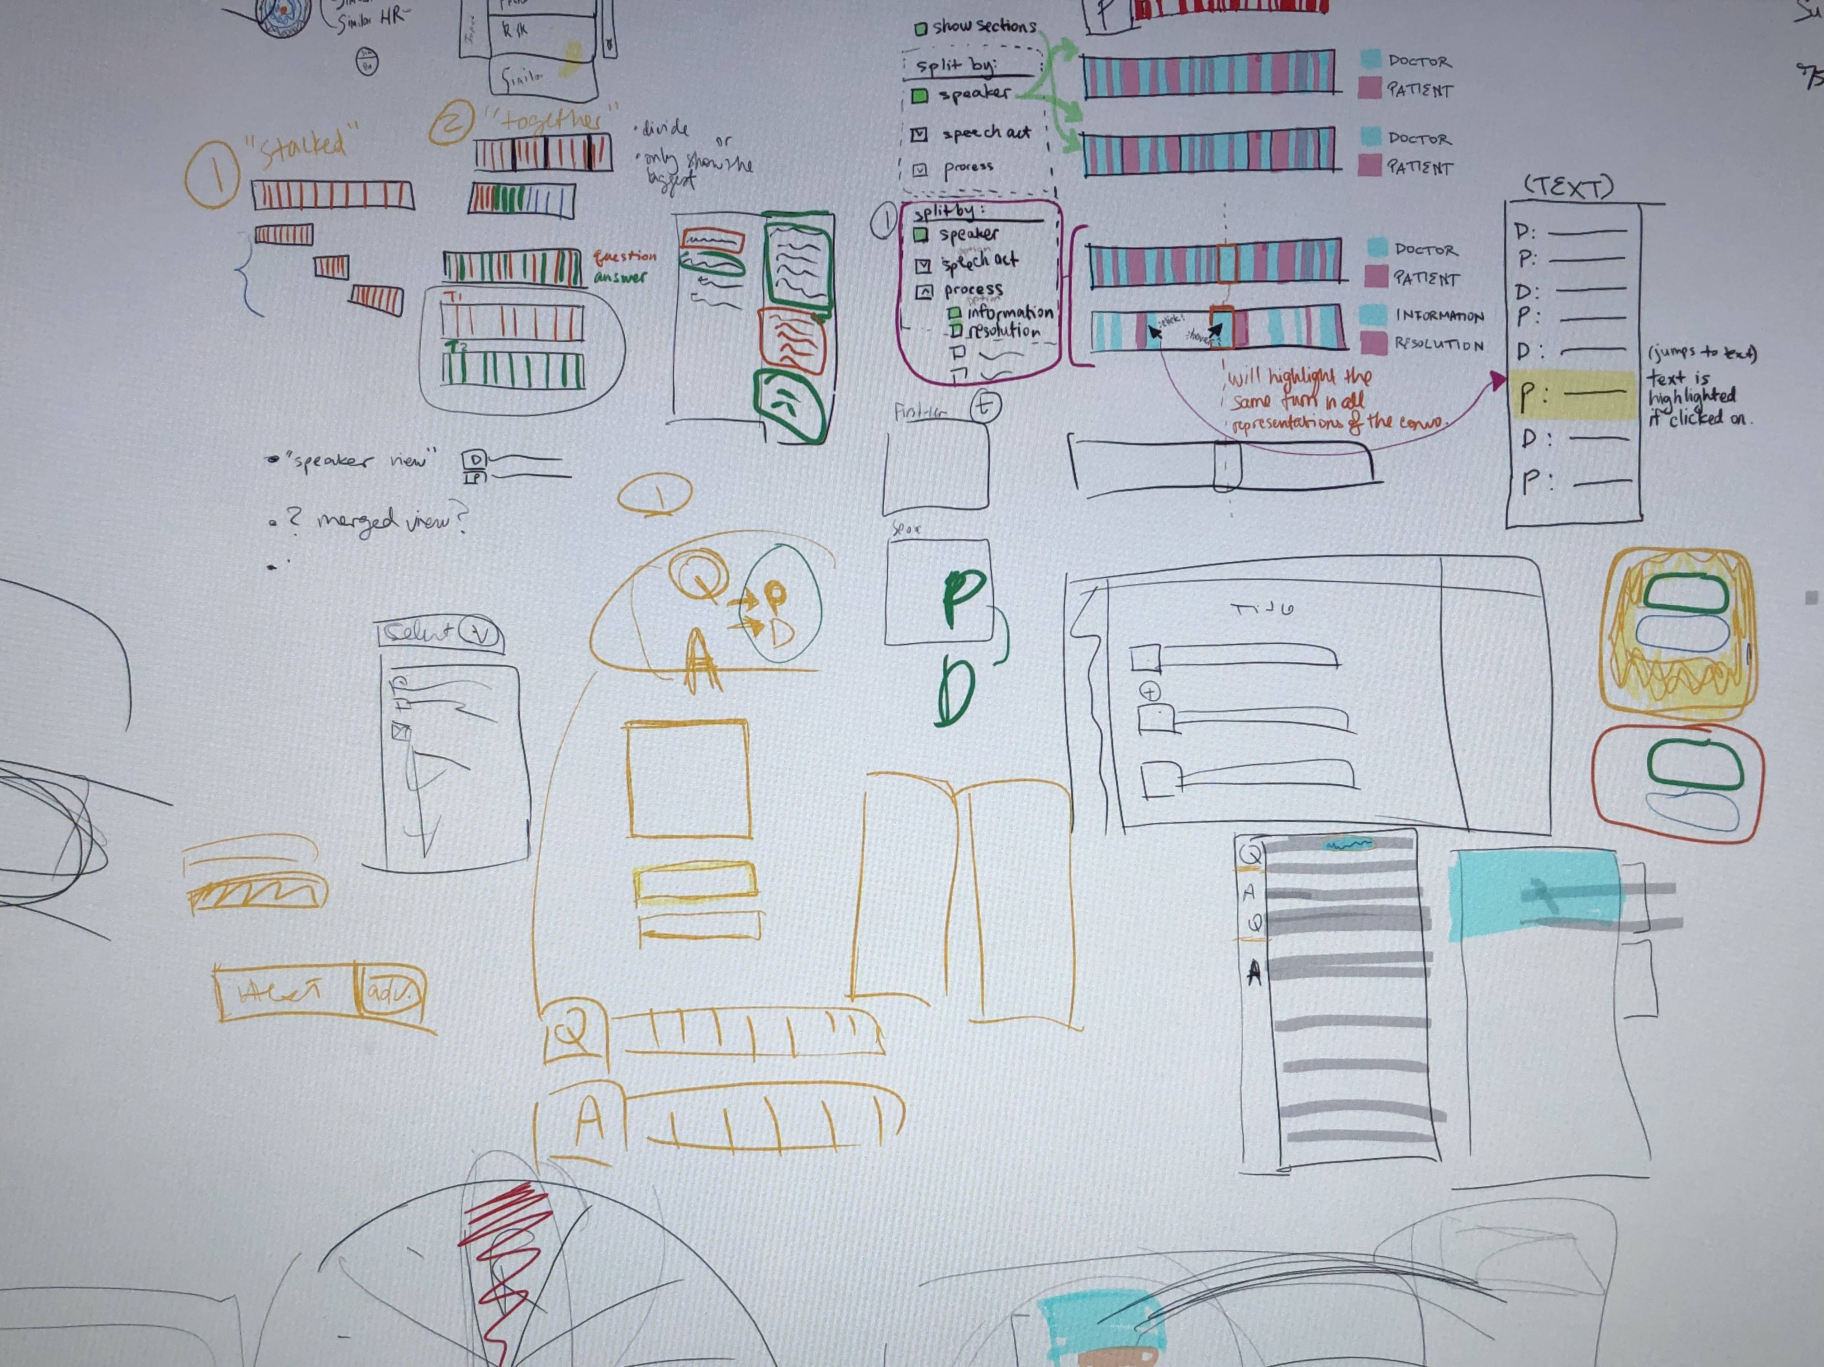
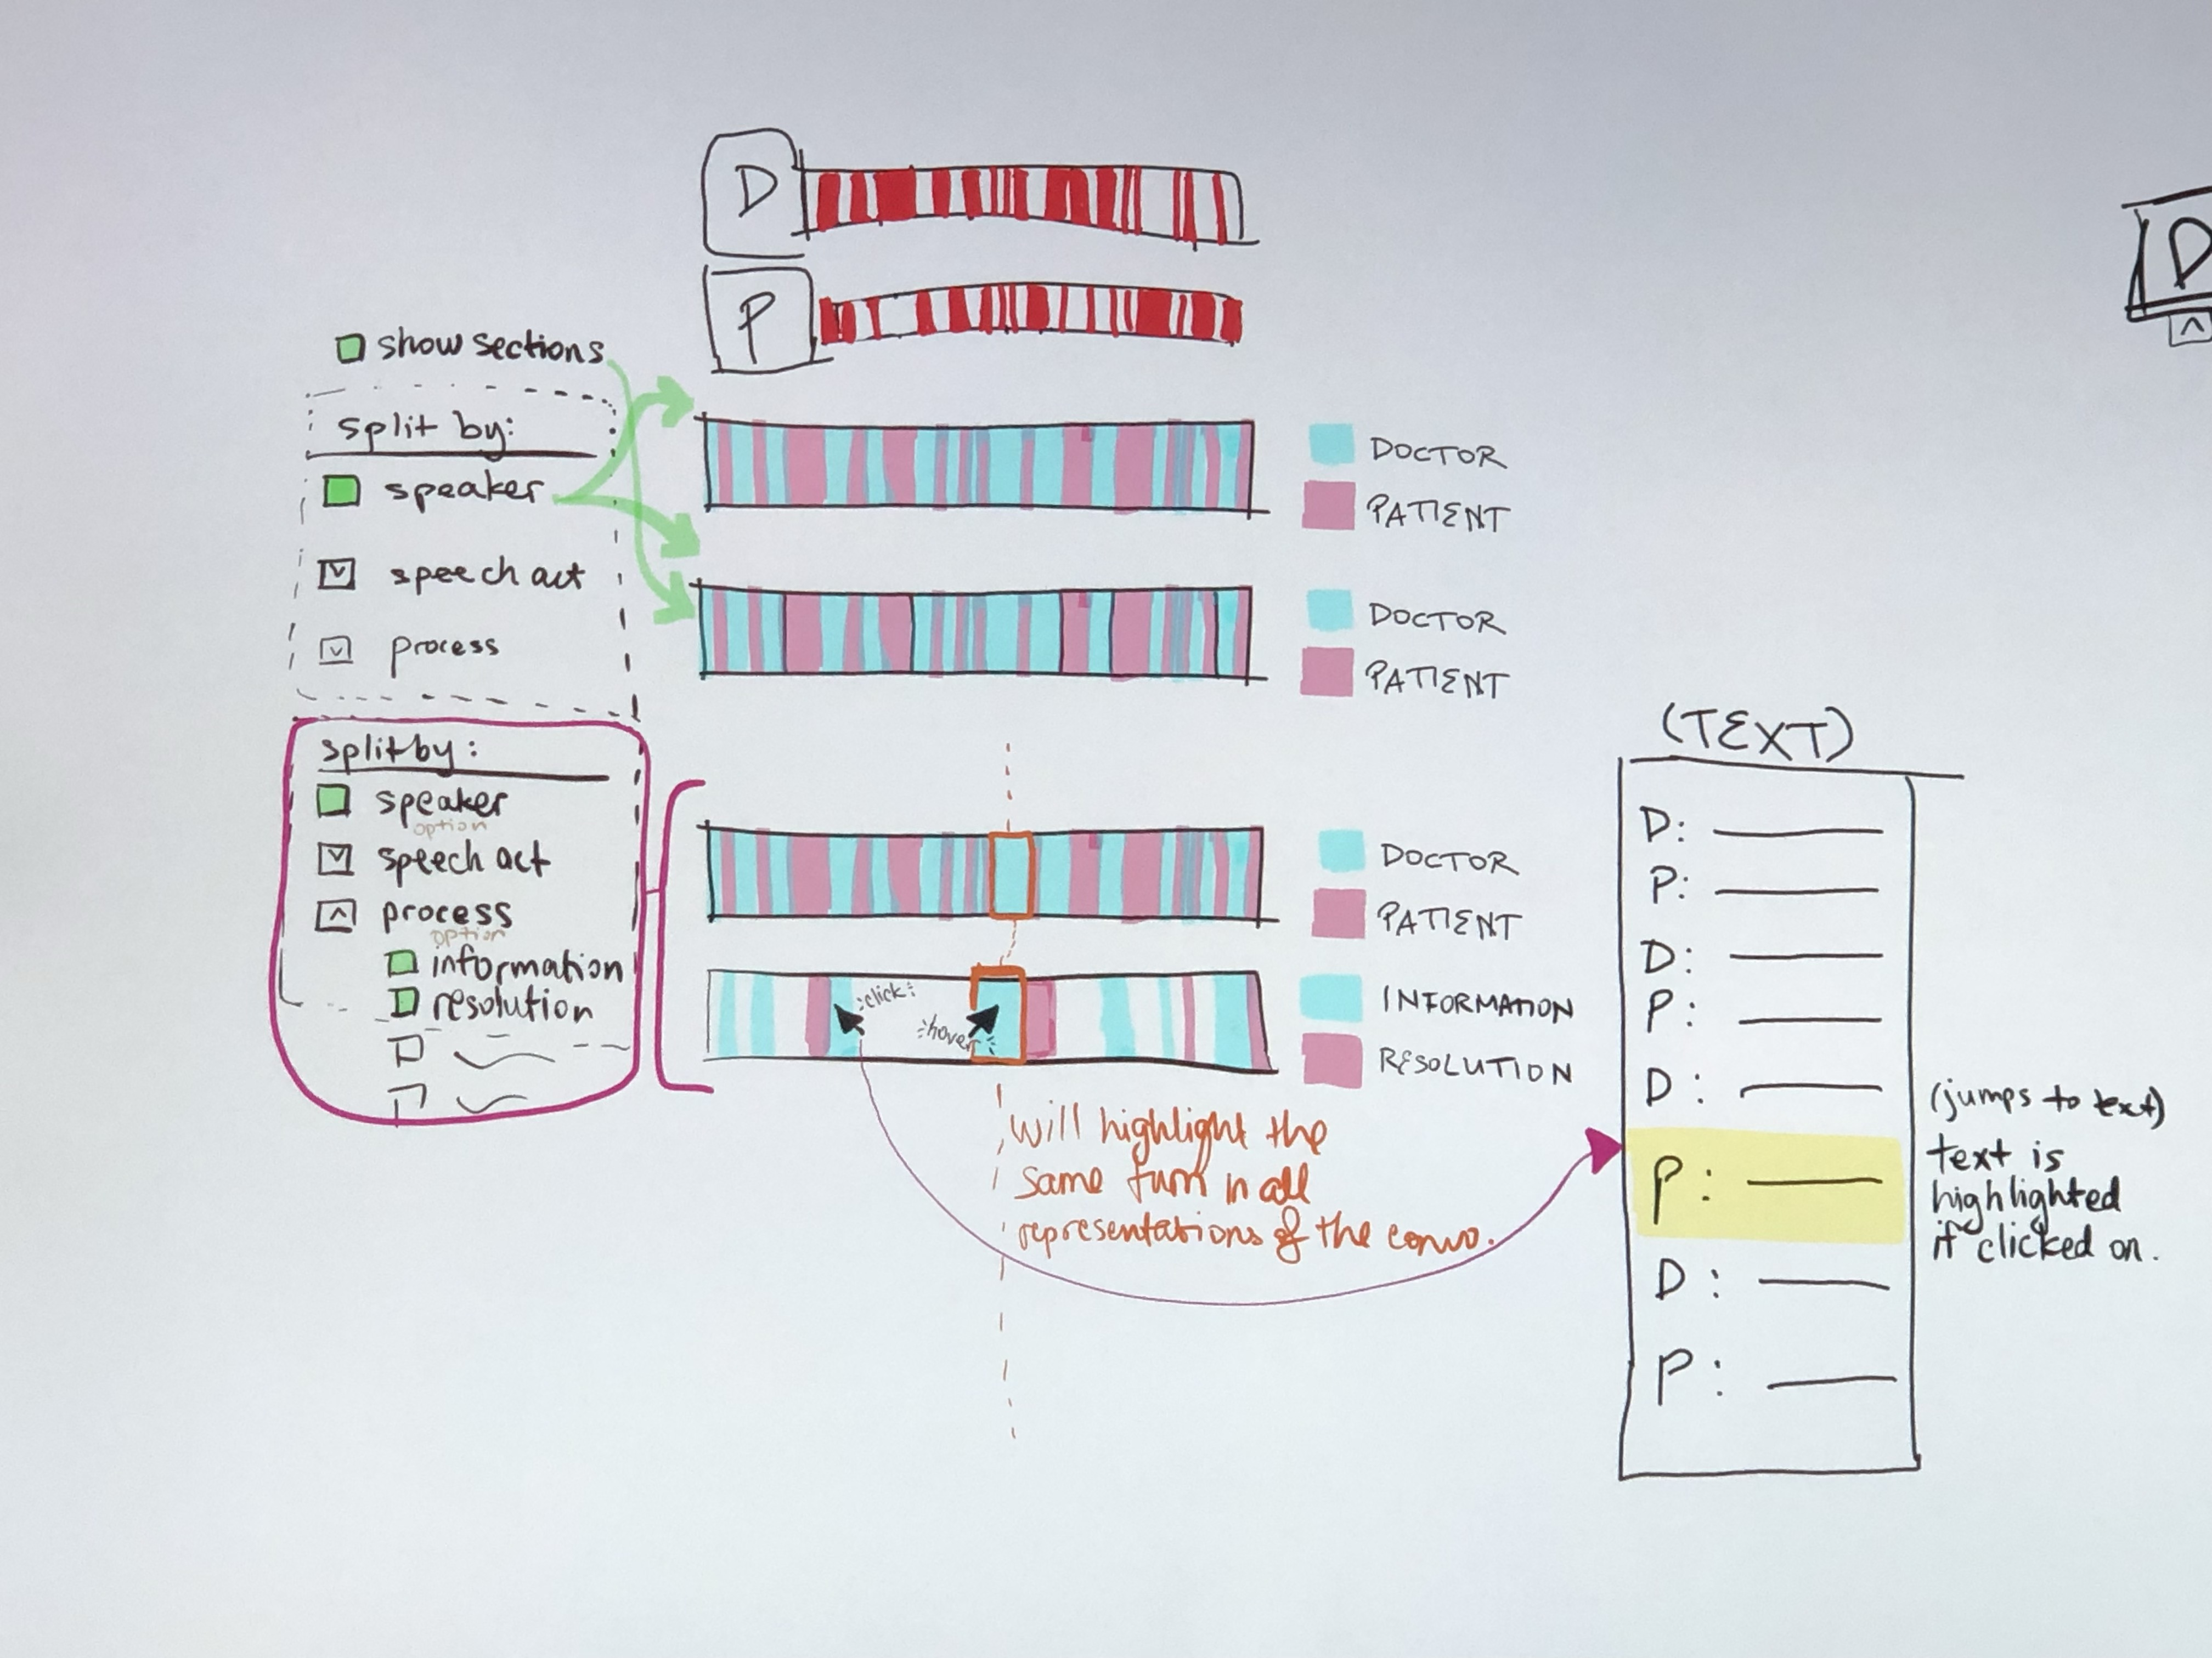
2nd and 3rd phase individual and team brainstorming:

Slide 8
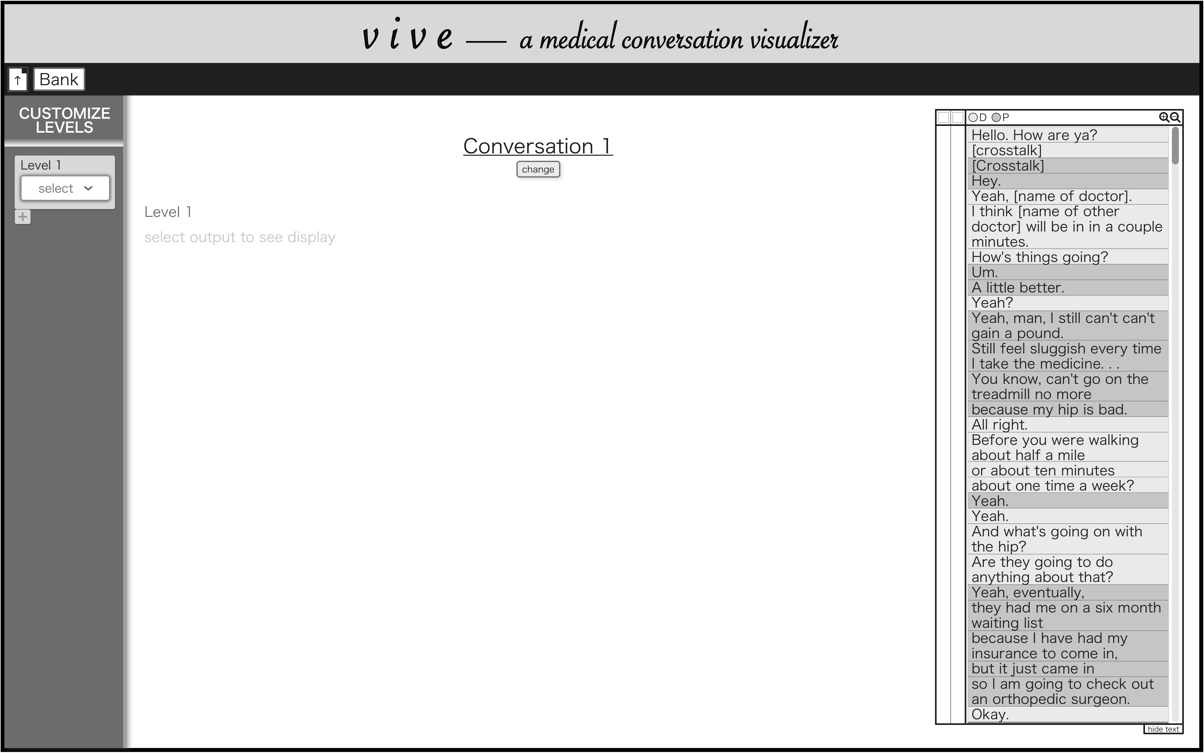
4th (final) phase of iterations:

Slide 9
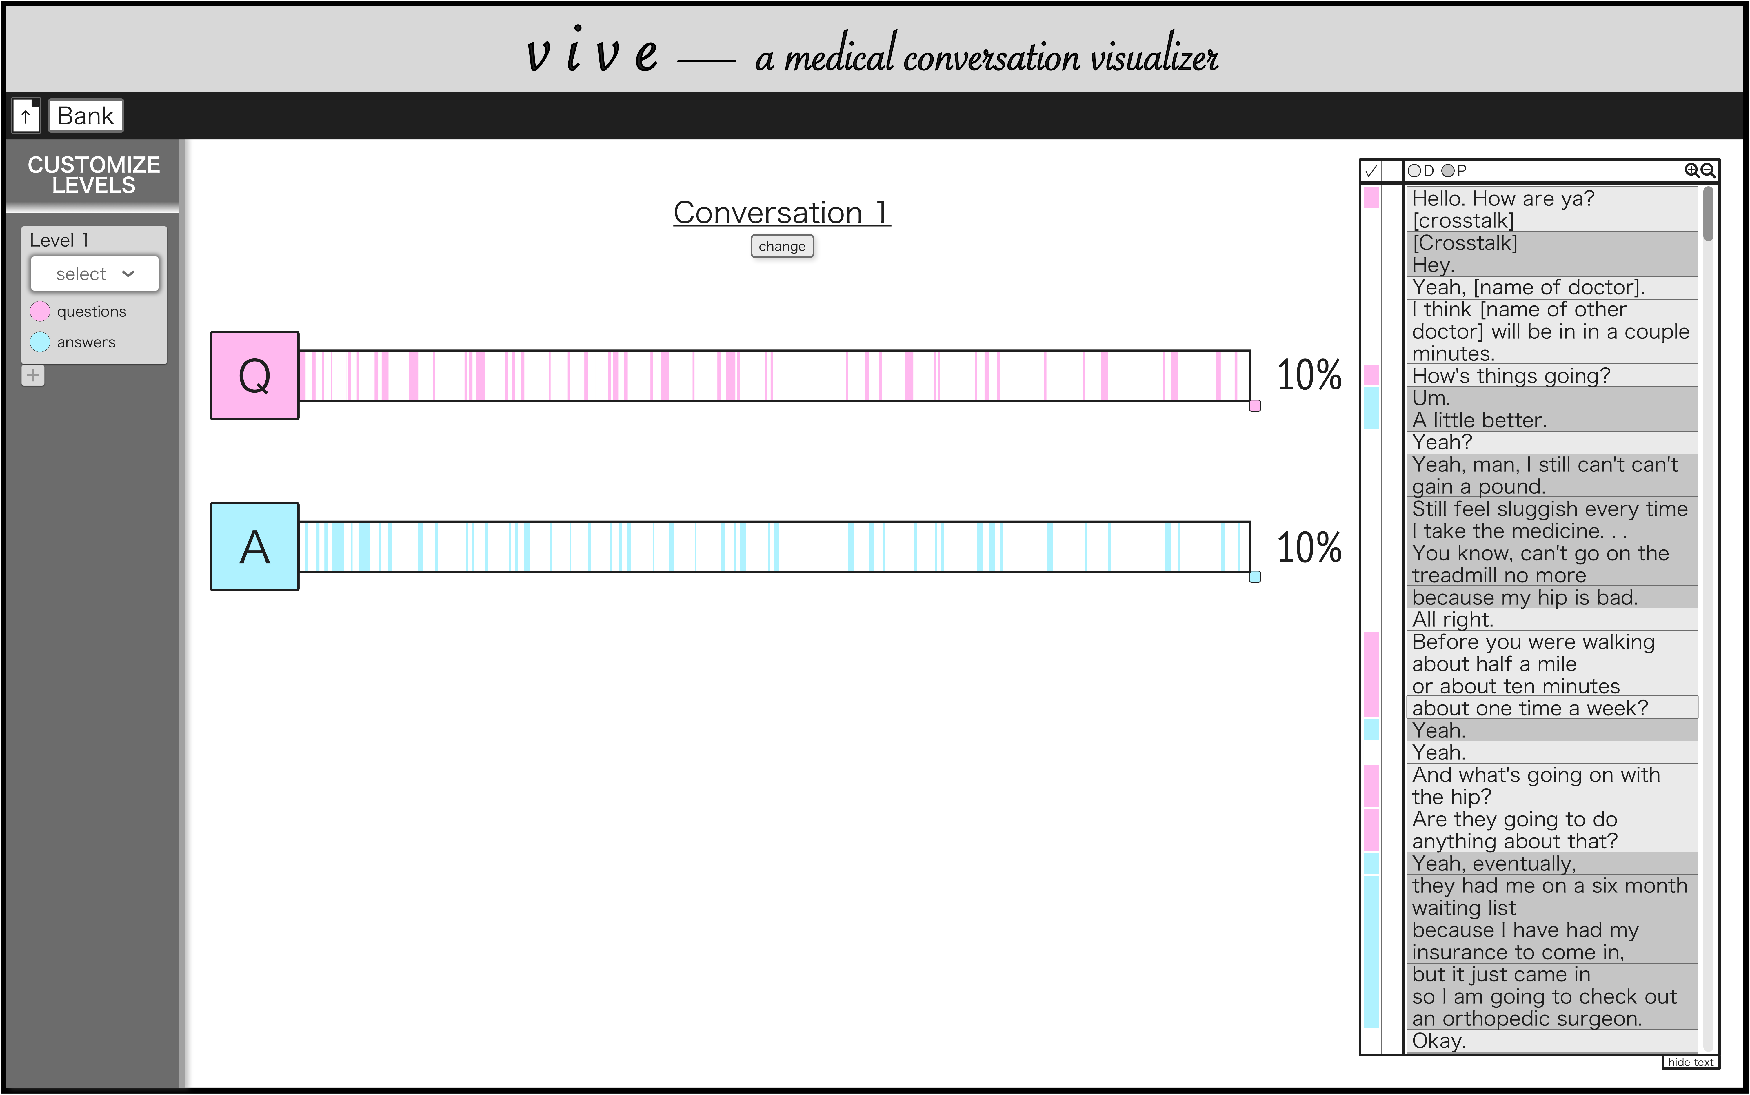
4th phase of iterations cont.:

Slide 10
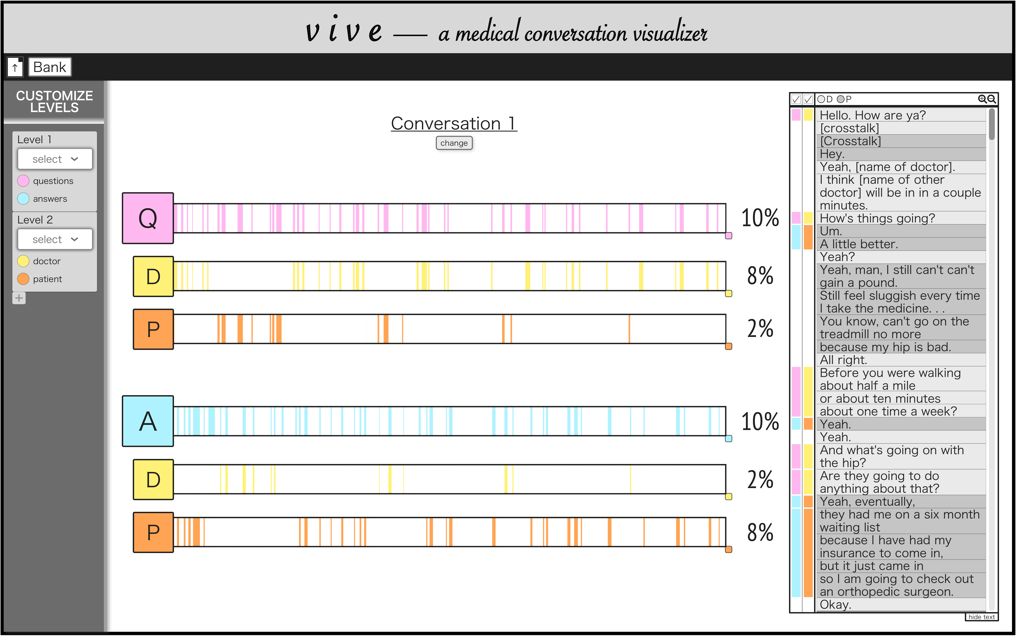
4th phase of iterations cont.:

Slide 11
3. Podcast Cover Art
Harvard classmate’s upcoming podcast featuring candid conversations with all kinds of people in the Harvard community (2019)
Created in Procreate

Slide 12
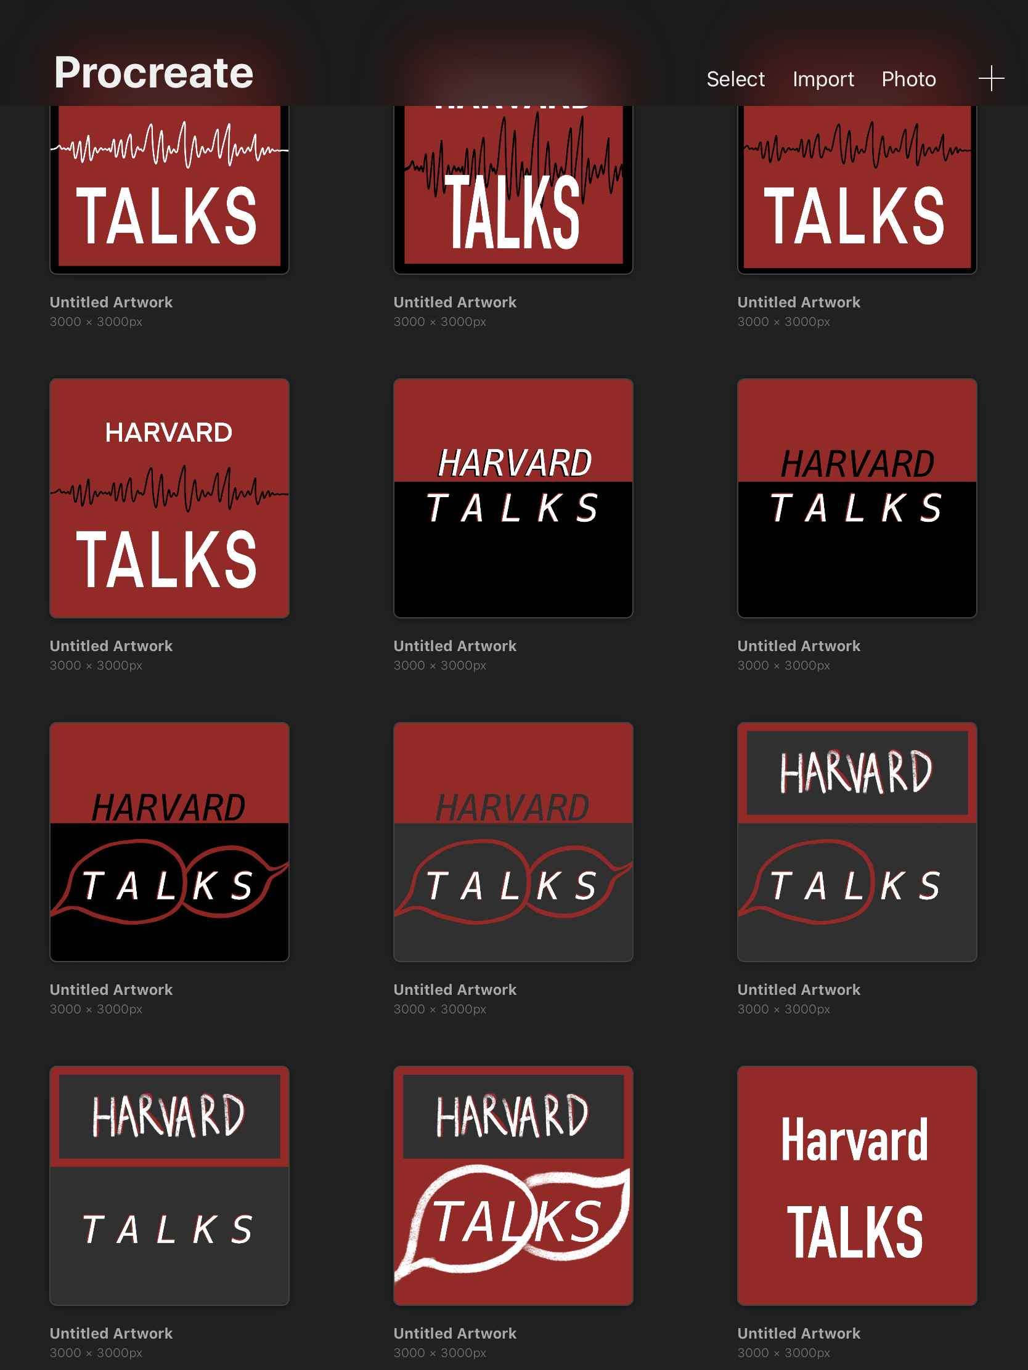
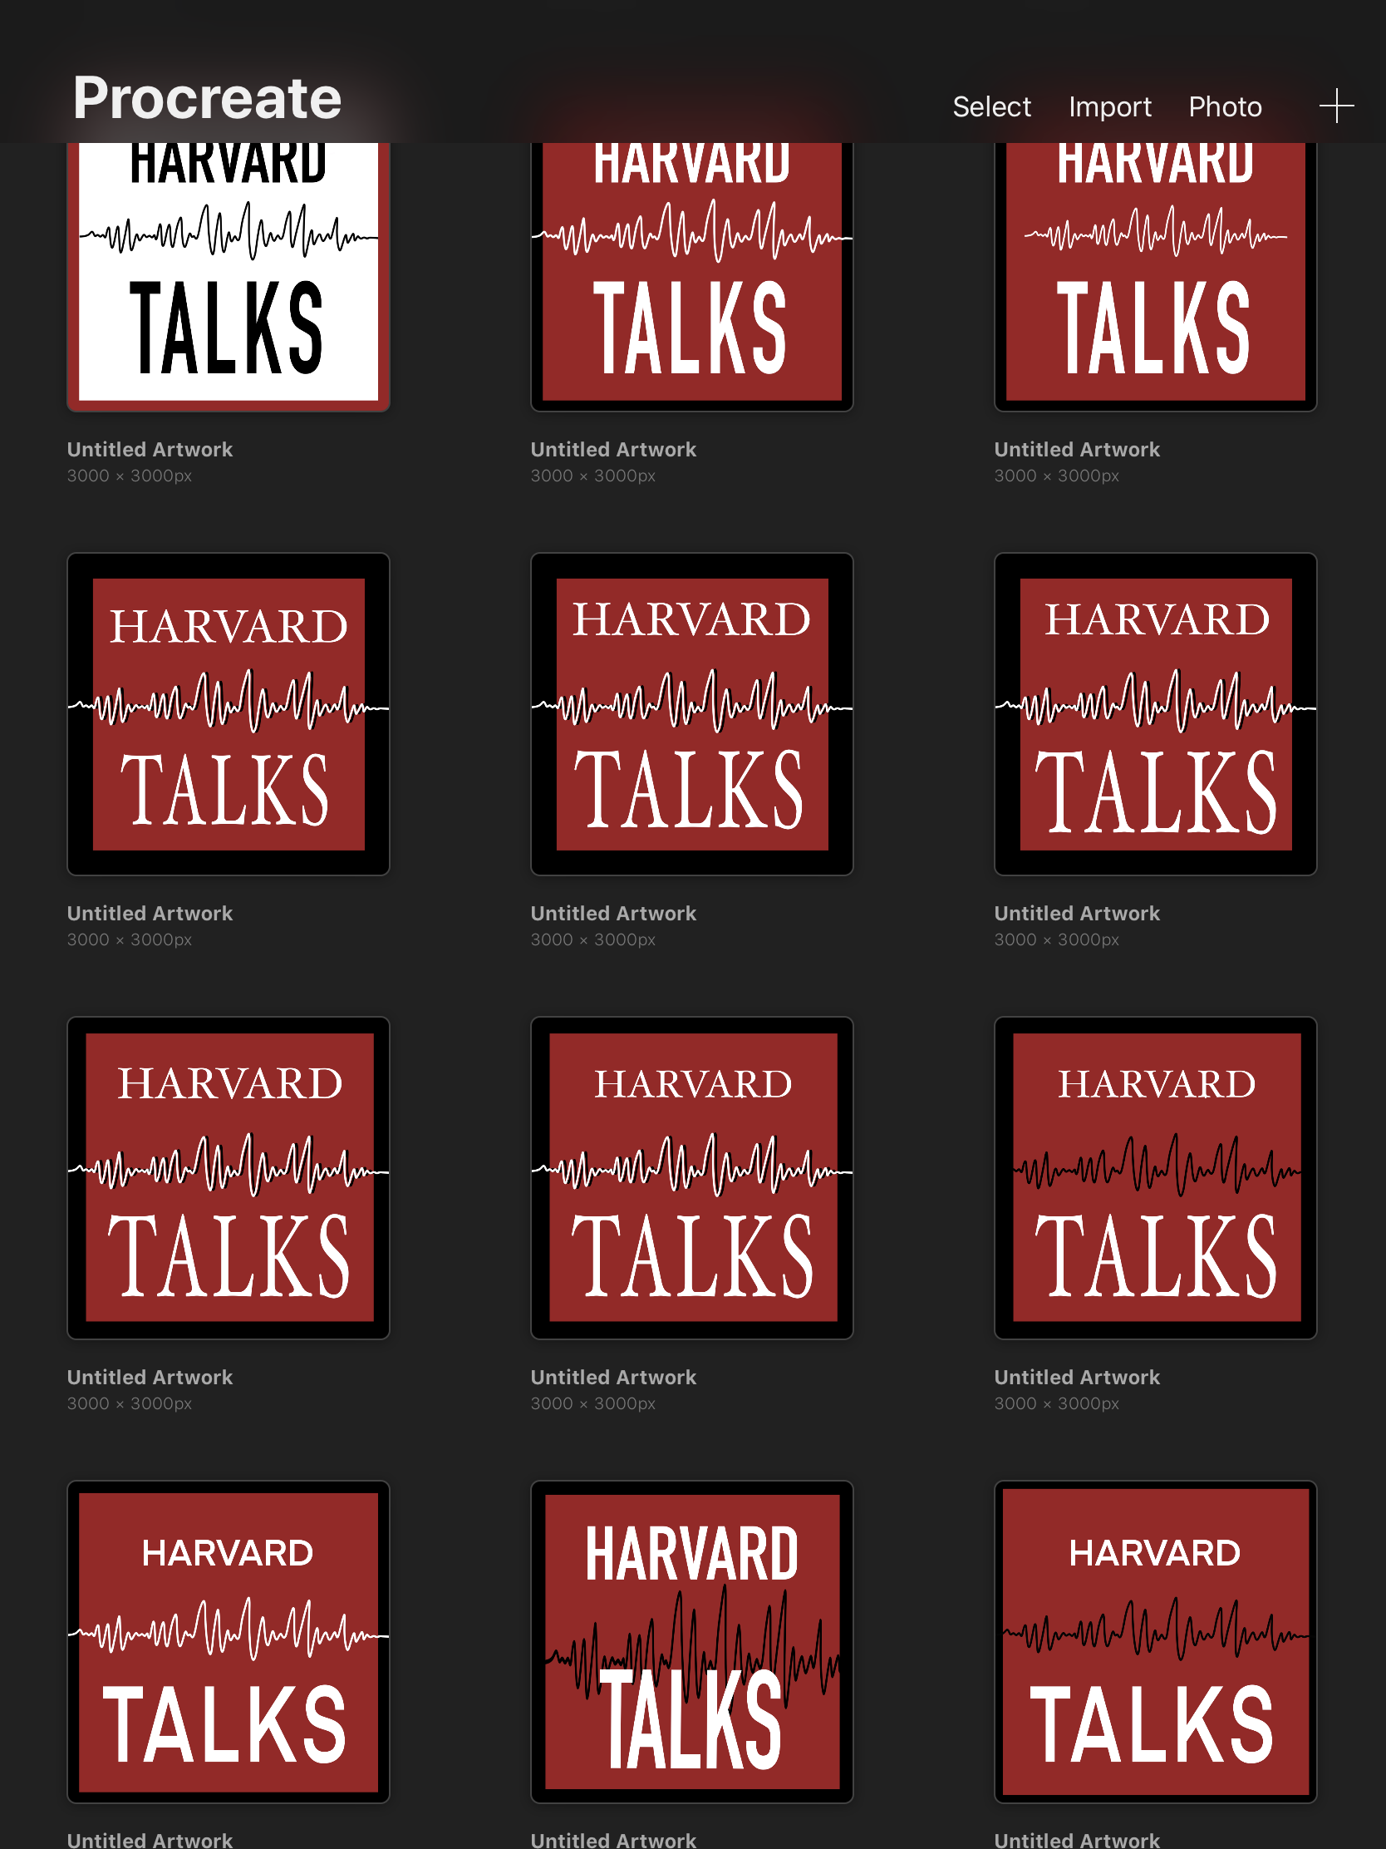
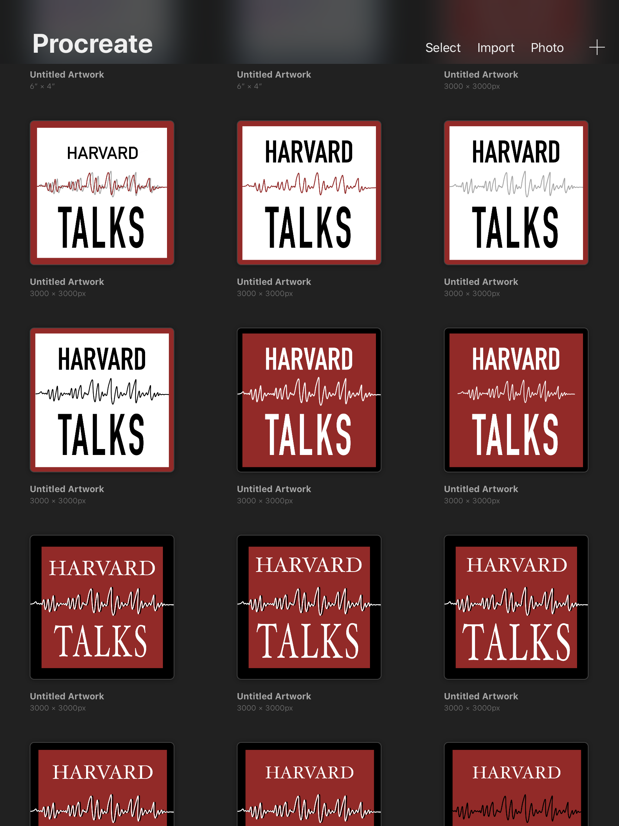
From left to right, bottom to top: initial brainstorms to various iterations via communication with the podcast creator:

Slide 13

The final chosen design:

Slide 14
4. Color-Emotion Association Website
Conceived and developed for Harvard’s Computer Science 50 class, capstone final open-ended project (2018)
Data collected through Google Forms survey
Website developed from scratch with Python, HTML, CSS, and JavaScript

Slide 15
Please view this video to see the project process and result:
https://www.youtube.com/watch?v=Pu63pSYtd34

